Slide 1
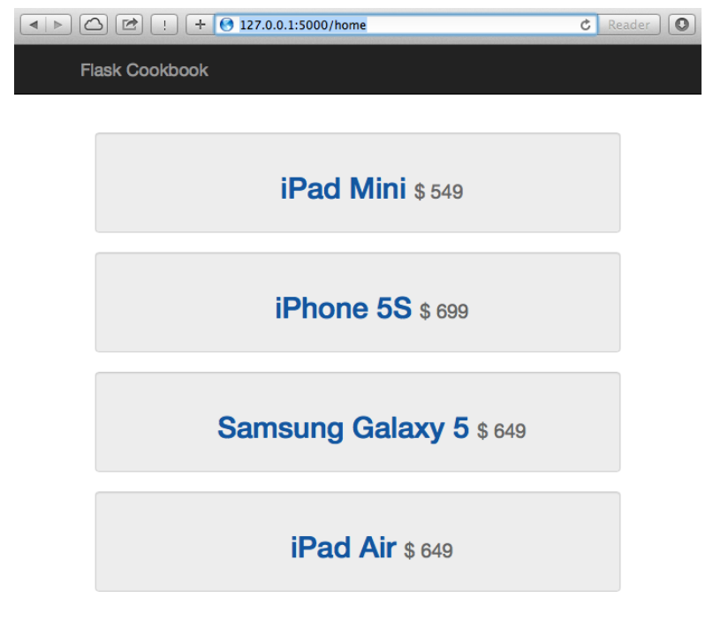
Login Page
Driving License Management System
Login
Registration

Slide 2
Registration Page
Driving License Management System
Login Page
Applicant login:
User ID
Login
Password
Registration
Login

Slide 3
Registration Page
Driving License Management System
Staff Login Page
Staff login:
User ID
Login
Password
Registration
Login

Slide 4
Registration Page
Driving License Management System
Applicant Registration
Applicant Registration:
First Name
Login
Middle Name
Last Name
Date of Birth
Registration
Mobile Number
Password
Confirm Password
Security Question
Answer
Sign Up

Slide 5
Home Page – Applicants
Driving License Management System
Home Page
Book a Trial
Cancel a Trial
View Results
Logout

Slide 6
Registration Page
Driving License Management System
Booking a Trial
Application form:
Login
Your application ID is: XXXXXX
Select Location
Select Date
Confirm

Slide 7
Cancel a Trial Page
Driving License Management System
Cancel a Trial
Application form:
Login
Your application ID is: XXXXXX
Selected Location
Selected Date
Cancel this trial

Slide 8
View Result Trial Page
Driving License Management System
View Results
Results of the Trial:
Login
Your application ID is: XXXXXX
Selected Location
Selected Date
Trial Status & Results
Back to home

Slide 9
Book a Trial Page – Applicants
Driving License Management System
Application Form:
Application Number: (Assigned by System)
Applicant ID: (Assigned by System)
Name:
National ID:
Date of application:
Booking date: (Select the date)
Submit

Slide 10
Cancel a Trial Page – Applicants
Driving License Management System
Application Number: (Assigned by System)
Applicant ID: (Assigned by System)
Name:
National ID:
Date of application:
Booking date: (Selected the date)
Cancel

Slide 11
View Result – Applicants
Driving License Management System
Application Number: (Assigned by System)
Applicant ID: (Assigned by System)
Name:
National ID:
Date of application:
Booking date: (Selected the date)
Status: Approved / Rejected / To be Reviewed
Back Home

Slide 12
Home Page – Admin Staff
Driving License Management System
Staff Home Page
Applicants Bookings Review
View History
Logout

Slide 13
Applications review – Admin Staff
Driving License Management System
Applications Verification
Application Number: 0001
Applicant ID:
Name:
National ID:
Date of application:
Approve
Reject
Application Number: 0002
Applicant ID:
Name:
National ID:
Date of application:
Approve
Reject
Application Number: 0003
Applicant ID:
Name:
National ID:
Date of application:
Approve
Reject
Back home

Slide 14
Applications history – Admin Staff
Driving License Management System
Applications History
Application Number:
Applicant ID:
Name:
National ID:
Date of application:
Status: APPROVED
Application Number:
Applicant ID:
Name:
National ID:
Date of application:
Status: REJECTED
Application Number:
Applicant ID:
Name:
National ID:
Date of application:
Status: APPROVED
Back home

